Slide 1
Lecture 9
Operating Systems (COMP1562)
Based on VMWARE WHITE PAPER

Slide 2

What is it used for?
Using a software normally destined for another operating system (software for Linux can be run on Windows and opposite) 
Simulation of many computers by one physical computer
Simulation of one computer by couple of computers with lesser resources/performance
Simulation of network administration/security related problems (virtual computers can „see” each other within the wirtual environment)
Running of a software potencially dangerous for the physical computer
Simulation other than real resource state (for example less RAM)
Compatibility tests
Mariusz Pelc © 2012/2013
(with support from Dr Kevin McManus and Dr Cos Ierotheou)

Slide 3
What is this actually?
Virtualization broadly describes the separation of a resource or request for a service from the underlying physical delivery of that service. With virtual memory, for example, computer software gains access to more memory than is physically installed, via the background wapping of data to disk storage.
A key benefit of virtualization is the ability to run multiple operating systems on a single physical system and share the underlying hardware resources – known as partitioning.
Mariusz Pelc © 2012/2013
(with support from Dr Kevin McManus and Dr Cos Ierotheou)

Slide 4
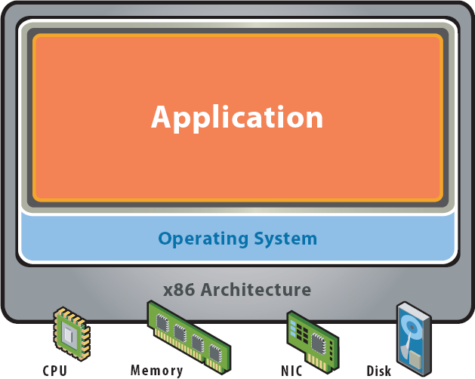
What is this actually?
Before virtualisation:
Single OS image per machine
Software and hardware tightly coupled
Running multiple applications on same machine often creates conflict
Underutilized resources
Inflexible and costly infrastructure
Mariusz Pelc © 2012/2013
(with support from Dr Kevin McManus and Dr Cos Ierotheou)

Slide 5
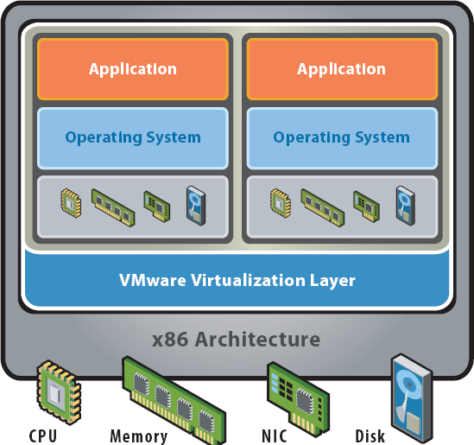
What is this actually?
After virtualisation:
Hardware-independence of operating system and applications
Virtual machines can be provisioned to any system
Can manage OS and application as a single unit by encapsulating them into virtual machines
Mariusz Pelc © 2012/2013
(with support from Dr Kevin McManus and Dr Cos Ierotheou)

Slide 6
Virtualisation – approaches
A hosted approach provides partitioning services on top of a standard operating system and supports the broadest range of hardware configurations.
In contrast, a hypervisor architecture is the first layer of software installed on a clean x86-based system (hence it is often referred to as a “bare metal” approach). Since it has direct access to the hardware resources, a hypervisor is more efficient than hosted architectures, enabling greater scalability, robustness and performance.
Mariusz Pelc © 2012/2013
(with support from Dr Kevin McManus and Dr Cos Ierotheou)

Slide 7
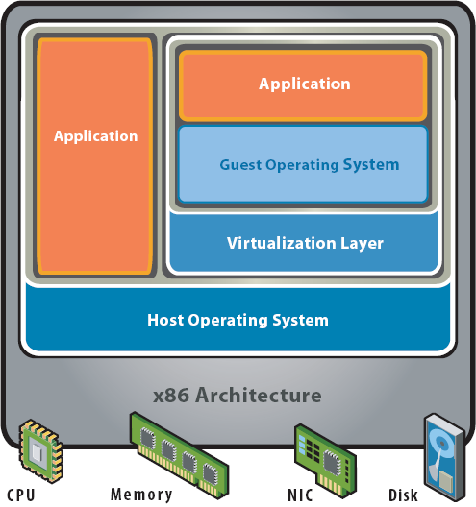
Virtualisation – approaches
Hosted architecture:
Installs and runs as an application
Relies on host OS for device support
Mariusz Pelc © 2012/2013
(with support from Dr Kevin McManus and Dr Cos Ierotheou)

Slide 8
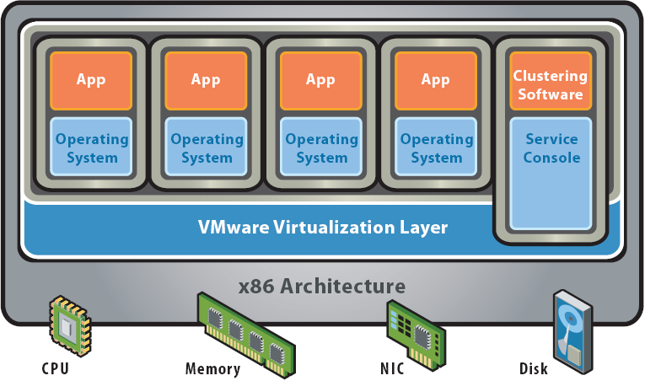
Virtualisation – approaches
Bare-Metal (Hypervisor) Architecture:
Lean virtualization-centric kernel
Service Console for agents and helperapplications
Mariusz Pelc © 2012/2013
(with support from Dr Kevin McManus and Dr Cos Ierotheou)

Slide 9
What is virtualisation so popular now?
Underutilized hardware
Today, many data centres have machines running at only 10 or 15 percent of total processing capacity. In other words, 85 or 90 percent of the machine’s power is unused.
Data centres run out of space
In case of companies explosion of data calls for new methods of data storage. These methods go by the common moniker of storage virtualization.
Green initiatives demand better energy efficiency
Impact of the green revolution has meant that companies are increasingly looking for ways to reduce the amount of energy they consume — and one of the places they look first is their data center.
System administration costs mount
Computers don’t operate all on their own. Every server requires care and feeding by system administrators. These tasks are pretty labor intensive.
Mariusz Pelc © 2012/2013
(with support from Dr Kevin McManus and Dr Cos Ierotheou)

Slide 10
Types of virtualisation
We have three types of virtualisation:
Full emulation
API emulation
Virtualisation
Mariusz Pelc © 2012/2013
(with support from Dr Kevin McManus and Dr Cos Ierotheou)

Slide 11
Full emulation
Entire computer emulation – virtual operating system, virtual memory, virtual resources (CPU, RAM, HDD, CD, buses, etc.)
The virtual computer performs tasks as if it was a physical computer with a real operating system installed
Each operation is emulated as it is being passed through the virtual layer to the real operating system kernel
Mariusz Pelc © 2012/2013
(with support from Dr Kevin McManus and Dr Cos Ierotheou)

Slide 12
Full emulation
Pros:
Very flexible
High portability
Full control of the VCE (Virtual Computer Environment) over the guest system (possible snapshots, reverting from shapshots, etc.)
Platform independent
Cons:
Not very fast
High abstraction of the real (host) mashine
Examples: Vmware Server/Workstation, Virtual Box, Microsoft Virtual PC
Mariusz Pelc © 2012/2013
(with support from Dr Kevin McManus and Dr Cos Ierotheou)

Slide 13
API emulation
Software solution treating running applications as separate processes
Applications use API interface to communicate with the host operating system
Replacement of all not system specific instructions with the instructions that can be performed by the real (host) system
Very often being done via porting / wrapping of some selected libraries (needed by the running application) of the emulated operating system
Mariusz Pelc © 2012/2013
(with support from Dr Kevin McManus and Dr Cos Ierotheou)

Slide 14
API emulation
Pros:
Faster than full emulation
No need to install a full operating system
Cons:
Some programs do not work
Not very high compatibility
Not very high portability
Examples: Wine for Linux
Mariusz Pelc © 2012/2013
(with support from Dr Kevin McManus and Dr Cos Ierotheou)

Slide 15
Virtualisation
A combination of the most important features of full emulation and API emulation
Another (guest) operating system may run in paralell to the host system or some other (guest) operating systems installed within the VCE
Virtualiser runs the guest operating system in the way making possible the best utilisation of the host computer resources
Only the instructions that cannot be done by the virtualiser are being emulated (translated)
Mariusz Pelc © 2012/2013
(with support from Dr Kevin McManus and Dr Cos Ierotheou)

Slide 16
Virtualisation types
Paravirtualisation
Is a virtualization technique that presents a software interface to virtual machines that is similar but not identical to that of the underlying hardware. It is being done via applying of an additional abstraction layer and hardware handling called hypervisor.
Full virtualisation
Is a virtualisation techinique where the Guest operating system has an impression as if it was working on the real hardware. In reality of the calls the virtualised operating system is making are being emulated every time in case of they collide with the other virtual envoronments or the Host operating system.
Mariusz Pelc © 2012/2013
(with support from Dr Kevin McManus and Dr Cos Ierotheou)

Slide 17
Virtualisation
Pros:
Faster than full emulation
More flexible than API emulation
Cons:
No easy portability to some other operating systems
Not possible to install any operating systems that are of different architecture than the architecture of the host computer
Mariusz Pelc © 2012/2013
(with support from Dr Kevin McManus and Dr Cos Ierotheou)

Slide 18
Virtual machines – which one to choose?
VMWare Workstation/Server,
Xen,
JVM – Java Virtual Machine,
K virtual machine – K Virtual Machine,
.NET CLR – Common Language Runtime,
PDB – Pervasive Debugging,
Parrot,
Bochs – PC emulator,
DOSEMU,
Microsoft Virtual PC,
Microsoft Virtual Server,
Microsoft Hyper-V,
QEMU,
KVM – Kernel-based Virtual Machine.
VirtualBox,
ScummVM,
Wine.
Mariusz Pelc © 2012/2013
(with support from Dr Kevin McManus and Dr Cos Ierotheou)

Slide 19
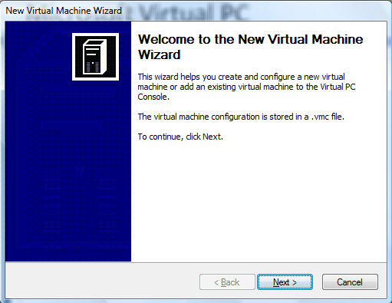
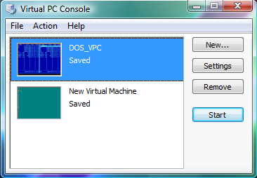
Microsoft Virtual PC
Mariusz Pelc © 2012/2013
(with support from Dr Kevin McManus and Dr Cos Ierotheou)

Slide 20
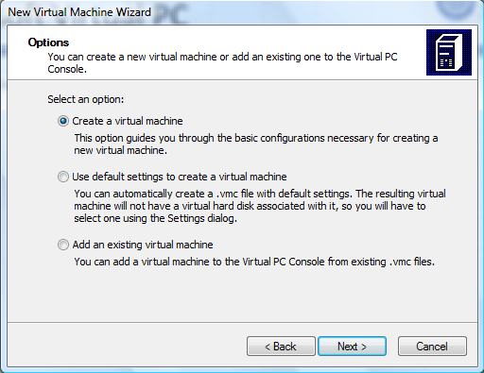
Microsoft Virtual PC
Mariusz Pelc © 2012/2013
(with support from Dr Kevin McManus and Dr Cos Ierotheou)

Slide 21
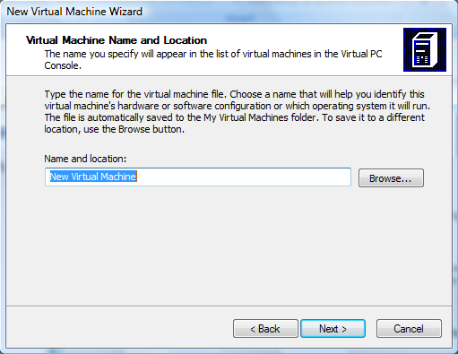
Microsoft Virtual PC
Mariusz Pelc © 2012/2013
(with support from Dr Kevin McManus and Dr Cos Ierotheou)

Slide 22
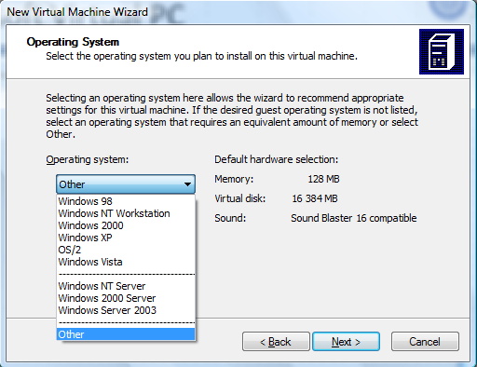
Microsoft Virtual PC
Mariusz Pelc © 2012/2013
(with support from Dr Kevin McManus and Dr Cos Ierotheou)

Slide 23
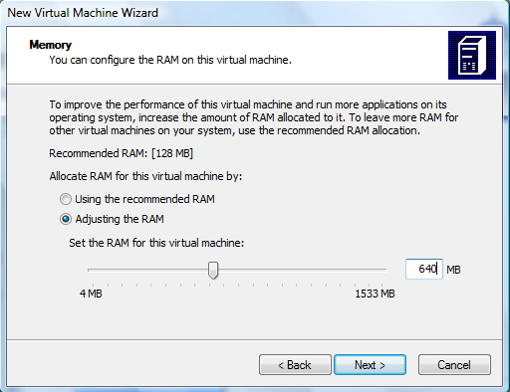
Microsoft Virtual PC
Mariusz Pelc © 2012/2013
(with support from Dr Kevin McManus and Dr Cos Ierotheou)

Slide 24
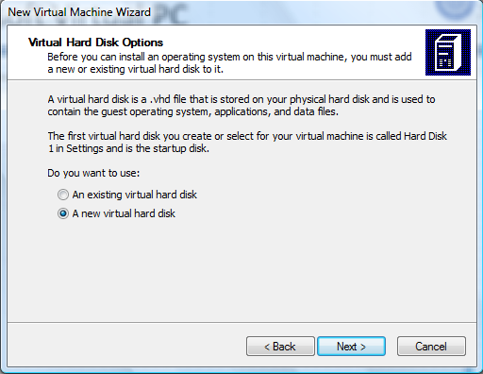
Microsoft Virtual PC
Mariusz Pelc © 2012/2013
(with support from Dr Kevin McManus and Dr Cos Ierotheou)

Slide 25
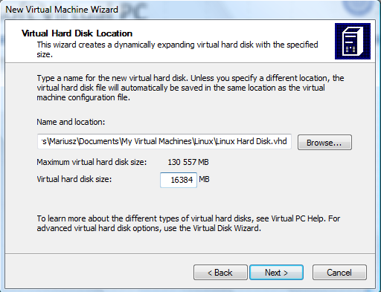
Microsoft Virtual PC
Mariusz Pelc © 2012/2013
(with support from Dr Kevin McManus and Dr Cos Ierotheou)

Slide 26
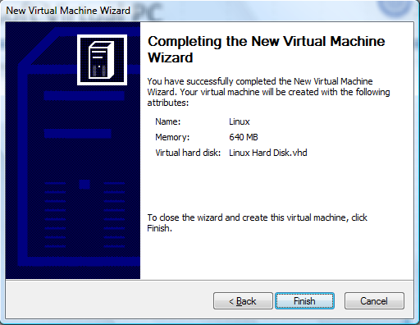
Microsoft Virtual PC
Mariusz Pelc © 2012/2013
(with support from Dr Kevin McManus and Dr Cos Ierotheou)

Slide 27
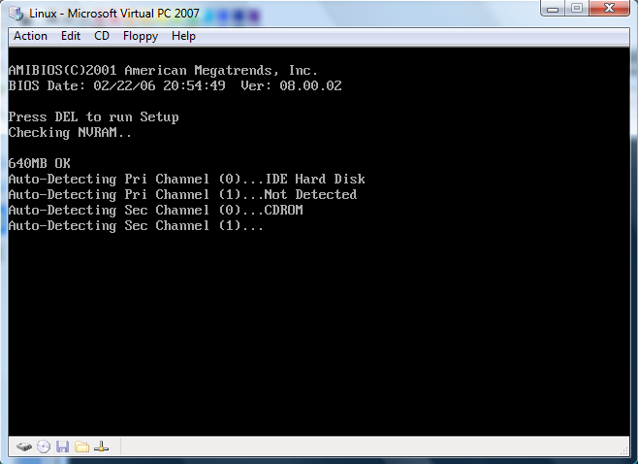
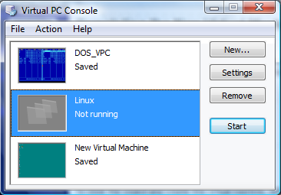
Microsoft Virtual PC
Mariusz Pelc © 2012/2013
(with support from Dr Kevin McManus and Dr Cos Ierotheou)

Slide 28
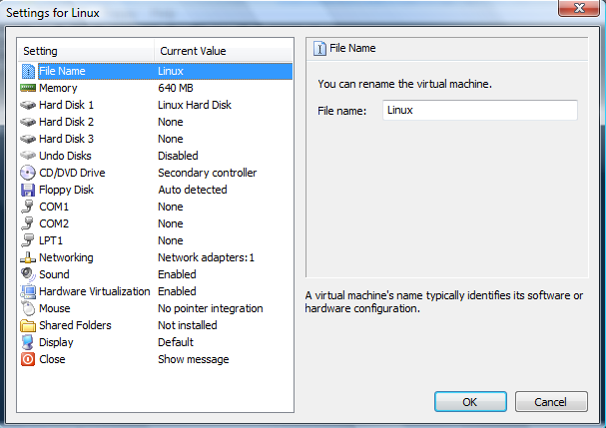
Microsoft Virtual PC
Mariusz Pelc © 2012/2013
(with support from Dr Kevin McManus and Dr Cos Ierotheou)

Slide 29
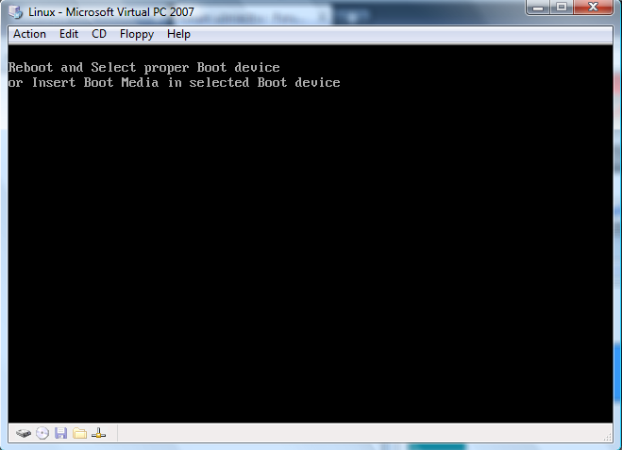
Microsoft Virtual PC
Mariusz Pelc © 2012/2013
(with support from Dr Kevin McManus and Dr Cos Ierotheou)

Slide 30
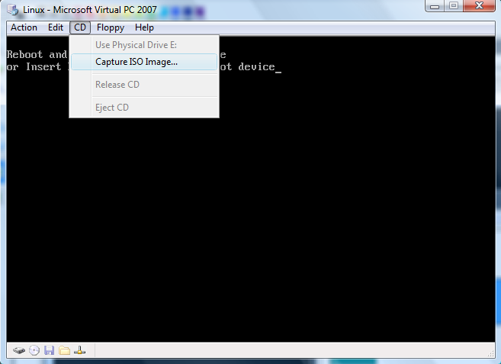
Microsoft Virtual PC
Mariusz Pelc © 2012/2013
(with support from Dr Kevin McManus and Dr Cos Ierotheou)

Slide 31
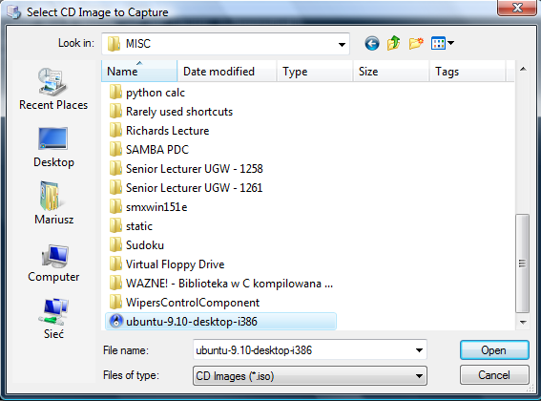
Microsoft Virtual PC
Mariusz Pelc © 2012/2013
(with support from Dr Kevin McManus and Dr Cos Ierotheou)

Slide 32
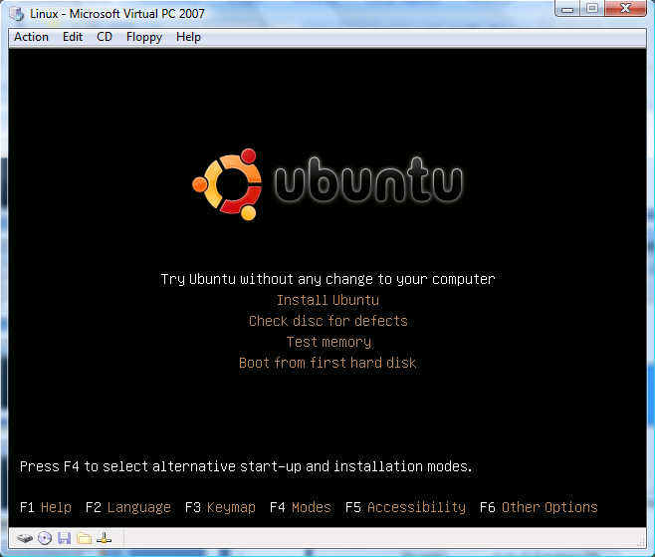
Microsoft Virtual PC
Mariusz Pelc © 2012/2013
(with support from Dr Kevin McManus and Dr Cos Ierotheou)

Slide 33
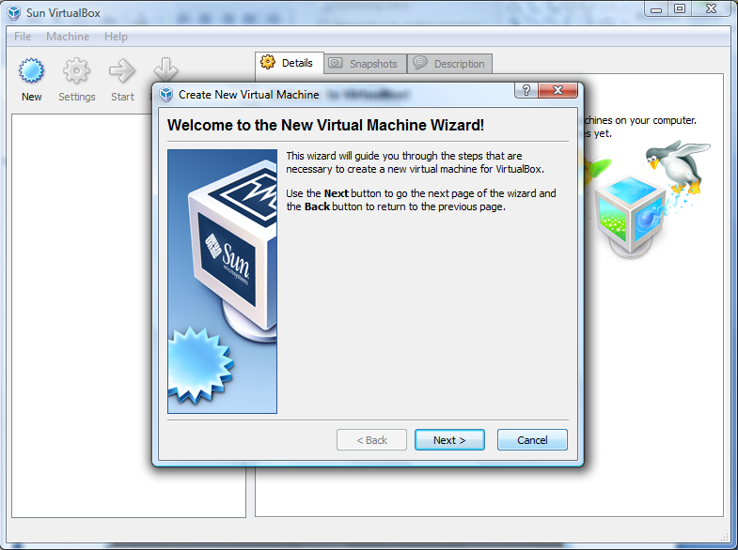
Sun Virtual Box
Mariusz Pelc © 2012/2013
(with support from Dr Kevin McManus and Dr Cos Ierotheou)

Slide 34
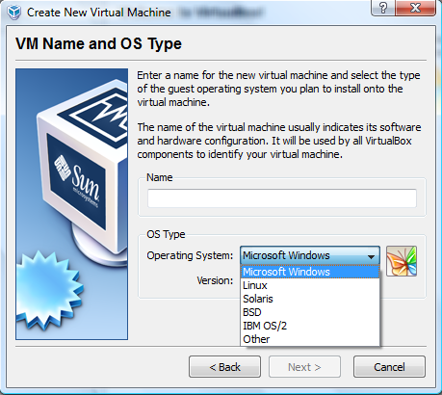
Sun Virtual Box
Mariusz Pelc © 2012/2013
(with support from Dr Kevin McManus and Dr Cos Ierotheou)

Slide 35
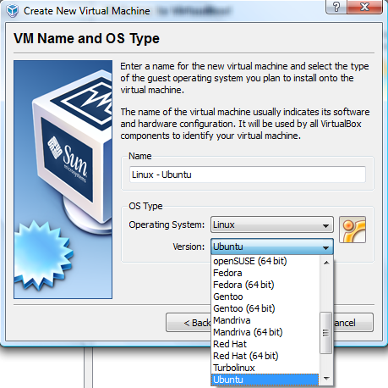
Sun Virtual Box
Mariusz Pelc © 2012/2013
(with support from Dr Kevin McManus and Dr Cos Ierotheou)

Slide 36
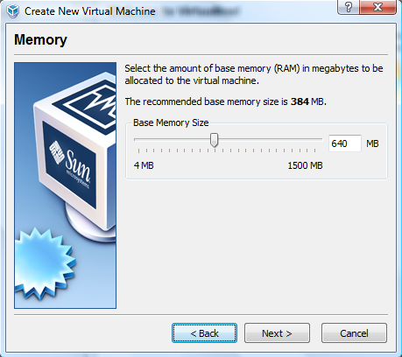
Sun Virtual Box
Mariusz Pelc © 2012/2013
(with support from Dr Kevin McManus and Dr Cos Ierotheou)

Slide 37
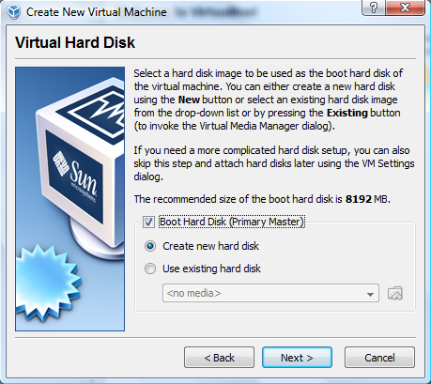
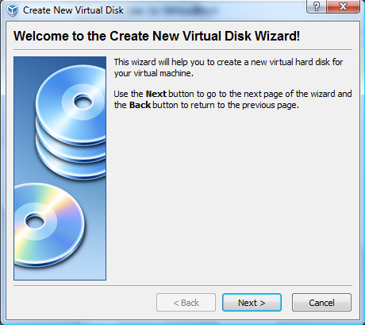
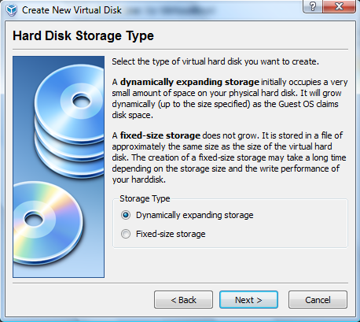
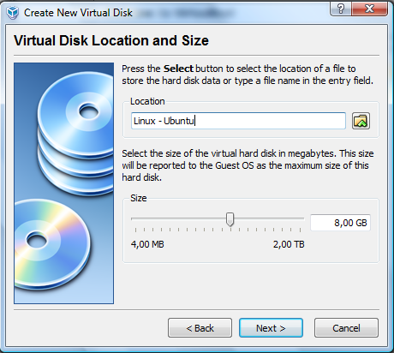
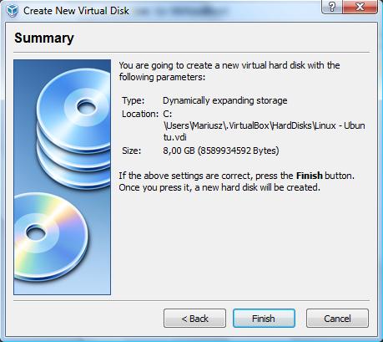
Sun Virtual Box
Mariusz Pelc © 2012/2013
(with support from Dr Kevin McManus and Dr Cos Ierotheou)

Slide 38
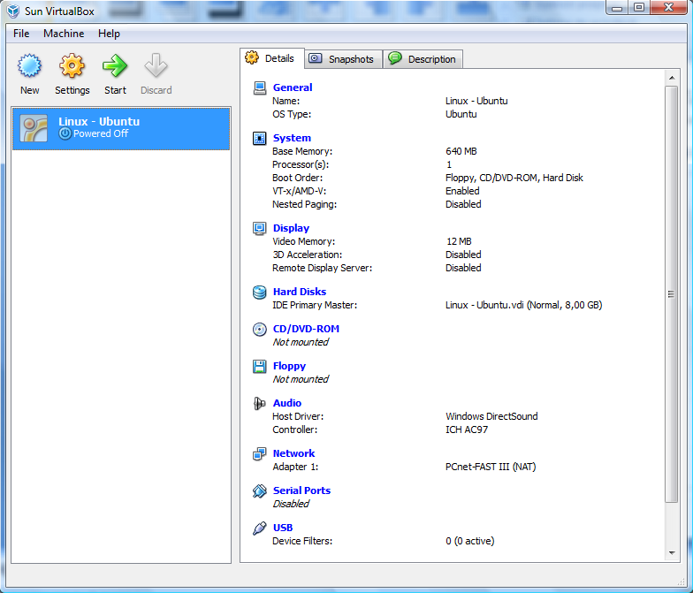
Sun Virtual Box
Mariusz Pelc © 2012/2013
(with support from Dr Kevin McManus and Dr Cos Ierotheou)

Slide 39
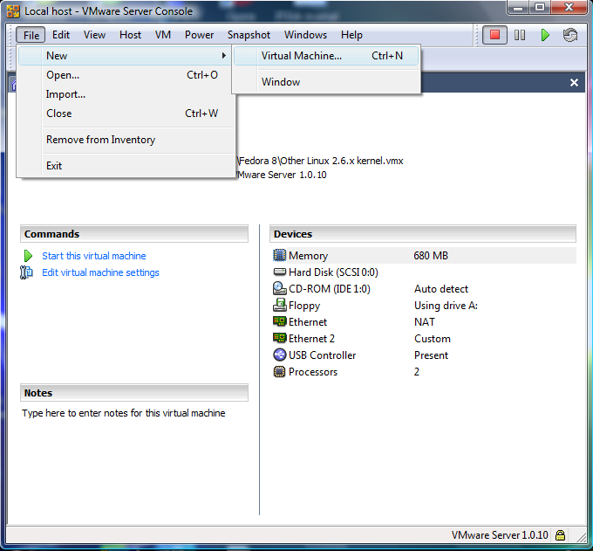
Vmware Server (1.X)
Mariusz Pelc © 2012/2013
(with support from Dr Kevin McManus and Dr Cos Ierotheou)

Slide 40
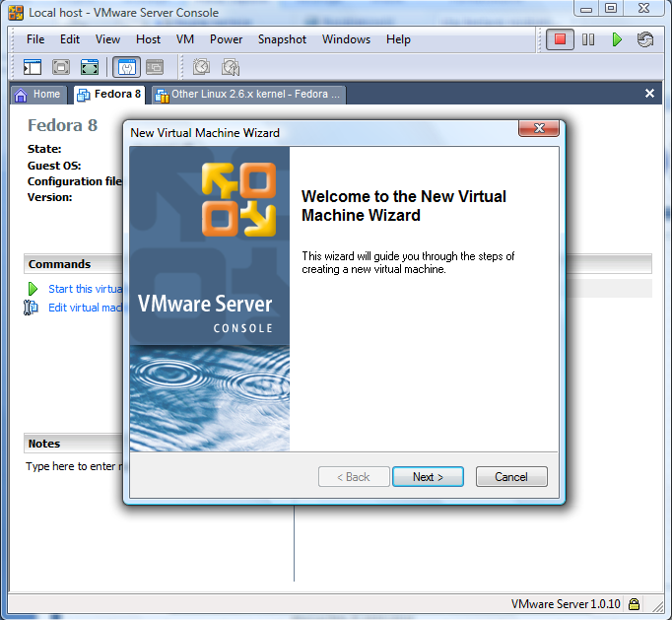
Vmware Server (1.X)
Mariusz Pelc © 2012/2013
(with support from Dr Kevin McManus and Dr Cos Ierotheou)

Slide 41
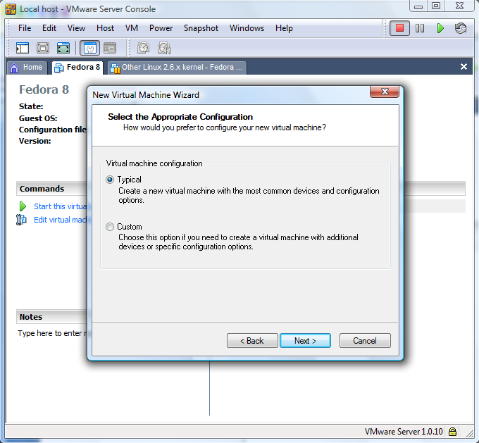
Vmware Server (1.X)
Mariusz Pelc © 2012/2013
(with support from Dr Kevin McManus and Dr Cos Ierotheou)

Slide 42
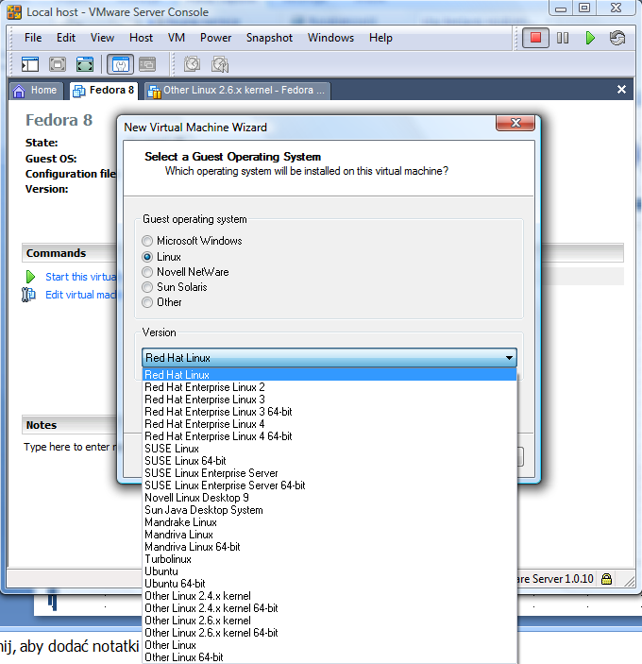
Vmware Server (1.X)
Mariusz Pelc © 2012/2013
(with support from Dr Kevin McManus and Dr Cos Ierotheou)

Slide 43
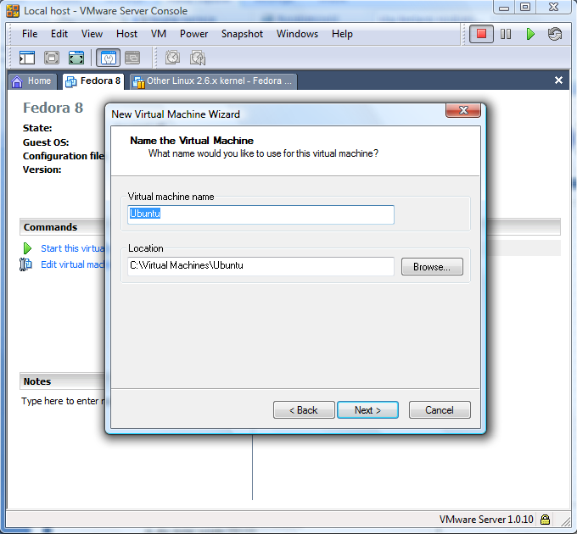
Vmware Server (1.X)
Mariusz Pelc © 2012/2013
(with support from Dr Kevin McManus and Dr Cos Ierotheou)

Slide 44
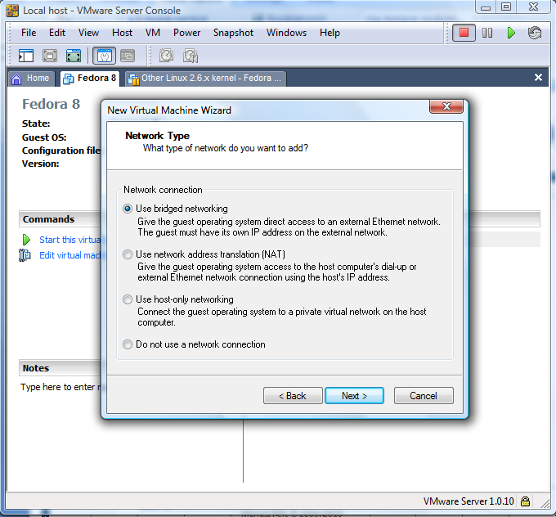
Vmware Server (1.X)
Mariusz Pelc © 2012/2013
(with support from Dr Kevin McManus and Dr Cos Ierotheou)

Slide 45
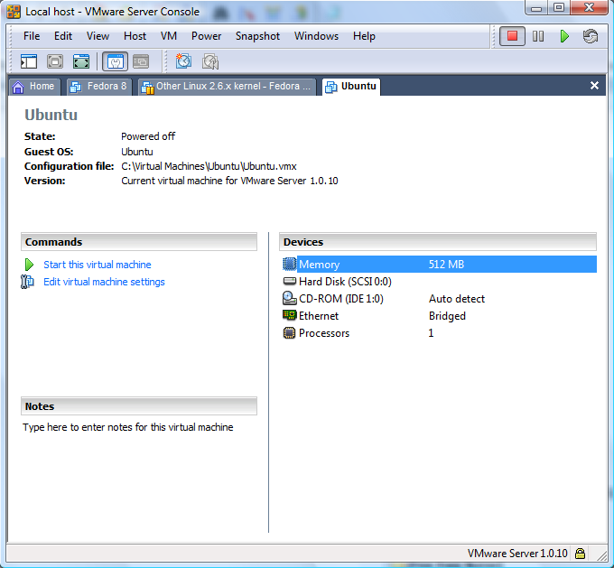
Vmware Server (1.X)
Mariusz Pelc © 2012/2013
(with support from Dr Kevin McManus and Dr Cos Ierotheou)

Slide 46
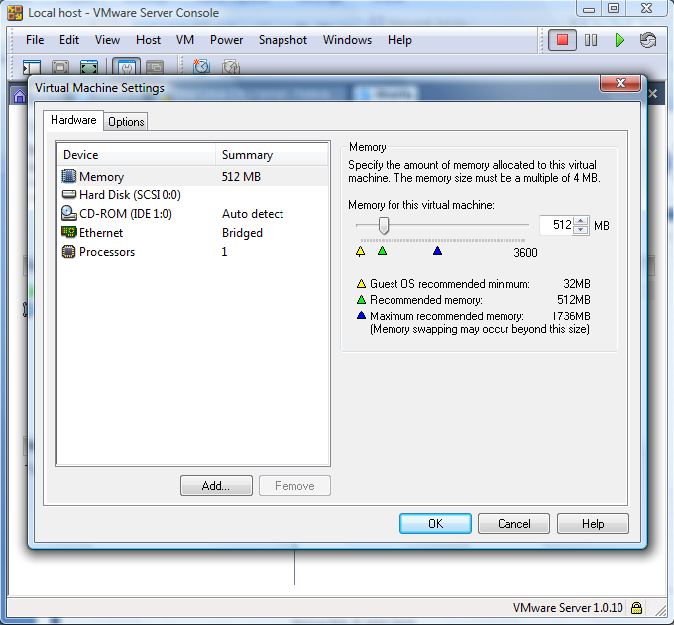
Vmware Server (1.X) – editing hardware
Mariusz Pelc © 2012/2013
(with support from Dr Kevin McManus and Dr Cos Ierotheou)

Slide 47
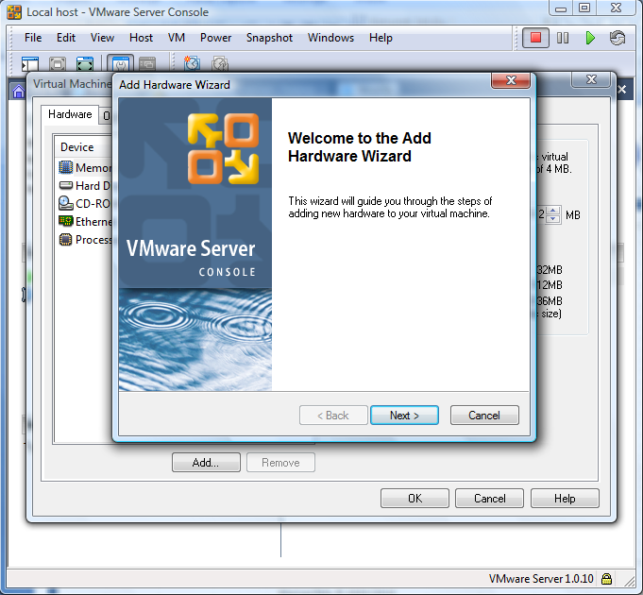
Vmware Server (1.X) – editing hardware
Mariusz Pelc © 2012/2013
(with support from Dr Kevin McManus and Dr Cos Ierotheou)

Slide 48
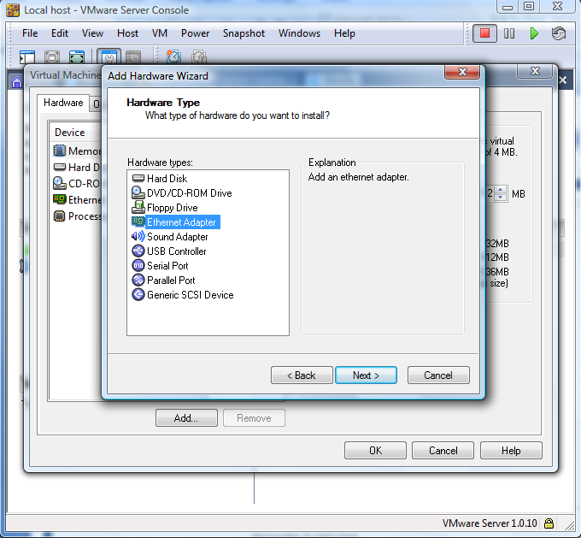
Vmware Server (1.X) – editing hardware
Mariusz Pelc © 2012/2013
(with support from Dr Kevin McManus and Dr Cos Ierotheou)

Slide 49
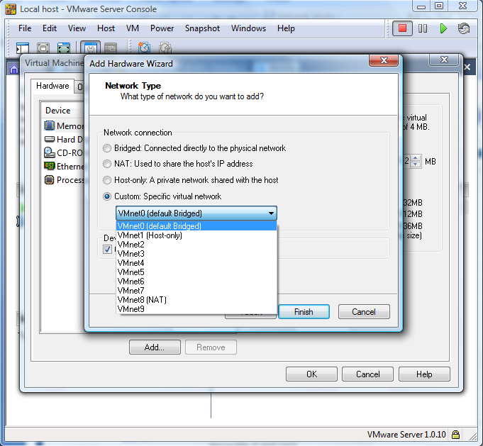
Vmware Server (1.X) – editing hardware
Mariusz Pelc © 2012/2013
(with support from Dr Kevin McManus and Dr Cos Ierotheou)

Slide 50
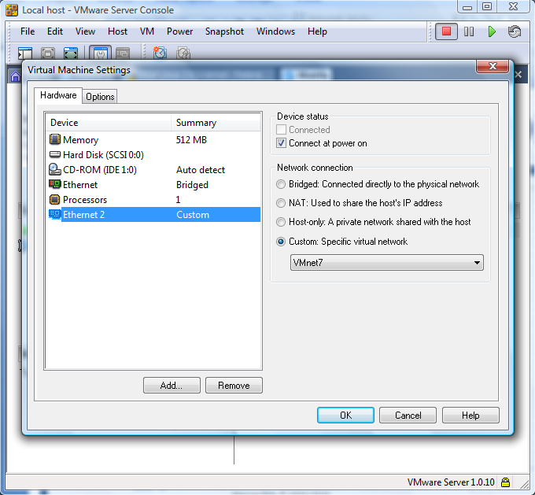
Vmware Server (1.X) – editing hardware
Mariusz Pelc © 2012/2013
(with support from Dr Kevin McManus and Dr Cos Ierotheou)

Slide 51
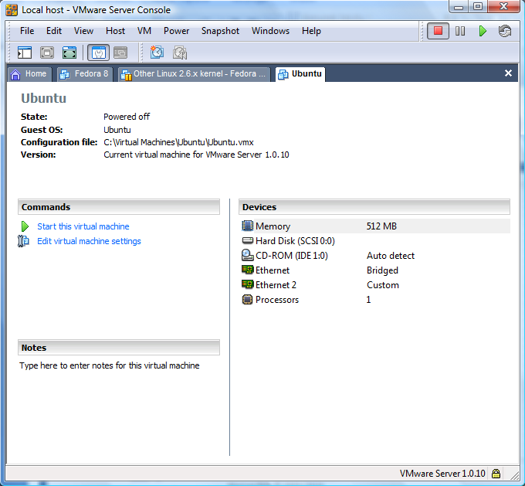
Vmware Server (1.X) – editing hardware
Mariusz Pelc © 2012/2013
(with support from Dr Kevin McManus and Dr Cos Ierotheou)

